Slide 1
Computer Audition
Research Report
by 刘畅 2016211650

Slide 2
01
Introduction
目录
Related to human audition
02
03
Computational models
04
Applications
CONTENTS
05
Huawei-Cup

Slide 3
01
Introduction to Computer Audition(CA)

Slide 4
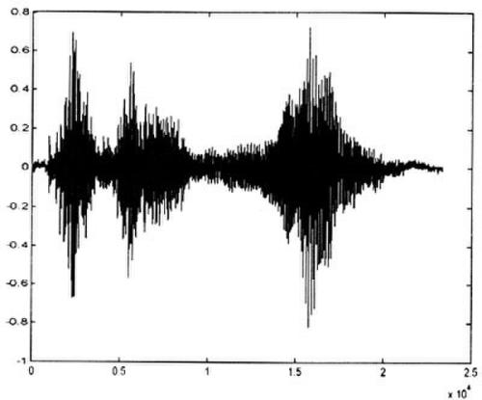
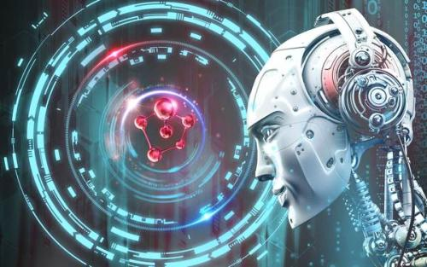
What is Computer Audition (CA)
Definition
study of algorithms and systems for the automatic analysis and understanding of sound by machine①
Analogy
Like computer vision versus image processing,computer audition versus audio engineering deals with understanding of audio rather than processing.
versus
① Machine Audition: Principles, Algorithms and Systems

Slide 5
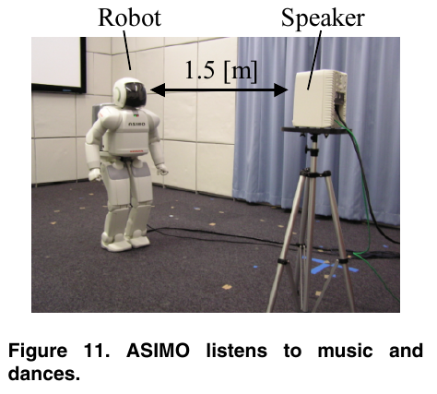
Why is Computer Audition (CA)
What can CA deal with ?
automatic audio indexing for internet searching
robust speech recognition in
un-controlled natural environment
speech enhancement for hearing aids
Audio Scene Analysis, Recognition and
Modeling
Robot audition
...

Slide 6
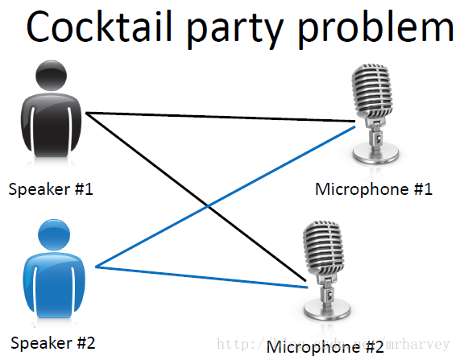
Why is Computer Audition (CA)
Problems in Computer Audition
Source separation
Representation
Feature extraction
Computational models
perception and cognition models
...

Slide 7
Not Only Computer Audition
electrical engineering
CA
musicology
acoustics
psychoacoustics
information retrieval
cognitive sciences
machine learning

Slide 8
02
Related to human audition

Slide 9

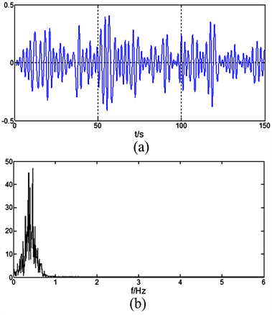
The goal of Computer Audition
• To bridge the gap between signal and cognition
What We Hear
What a Computer Hear

Slide 10

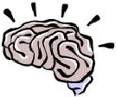



What is the relationship
Sensing(device)
Interpreting(device)
Interpretations
sound(music)
分类：女声
人物：李丽芬
歌曲：爱江山更爱美人
风格：大气流畅
...
g:Vhâ∆…
Lecture1
-
9
ã°{óg:[fñb

Slide 11
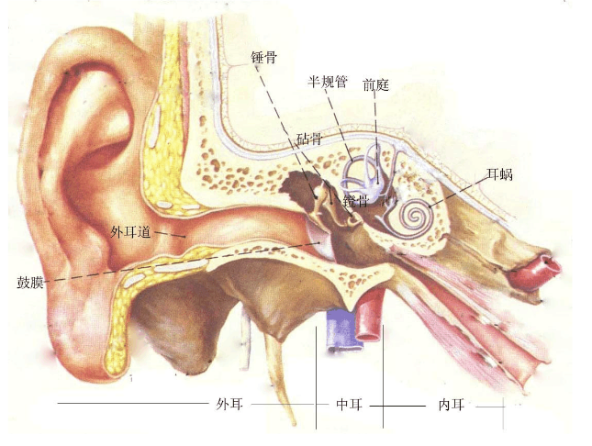
How does it work in human's brains
the unidimensional sound signal is transformed
in a distributed representation along the length
of the cochlea by the outer/middle ear,
representation is then converted in the second stage into a pattern of electrical activity on thousands of auditory nerve fibers by inner hair cell
perceptual representations of timbre and pitch are extracted from these patterns(feature extractions)
Computational models of music perception and cognition I:The perceptual and cognitive processing chain
g:Vhâ∆…
Lecture1
-
9
ã°{óg:[fñb

Slide 12
Auditory Model
outer and middle ear(cochlea) combined show a response curve maximal between 1 and 3 kHz and decreasing towards lower and higher frequencies.5 For imitating various pitch phenomena the effect can be implemented as a band pass filter.
analysis
Each frequency of an incoming sound sets the basilar membrane maximally into motion at a particular position. The logarithm of the sound frequency and the distance between the position of maximal motion and the apex of the basilar membrane are approximately proportional . The major properties of the hair cell in the inner ear are temporal coding and adaptation behavior
transduction
In the auditory cortex(most probably in primary and adjacent secondary auditory fields), more specific information about acoustic features, such as pitch height, pitch chroma, timbre, intensity and roughness is extracted. The details about how and where in the auditory cortex these features are extracted are still not well understood.①
reduction
① Koelsch S, Siebel WA. Towards a neural basis of music perception
Lecture1
-
9
ã°{óg:[fñb
g:Vhâ∆…

Slide 13
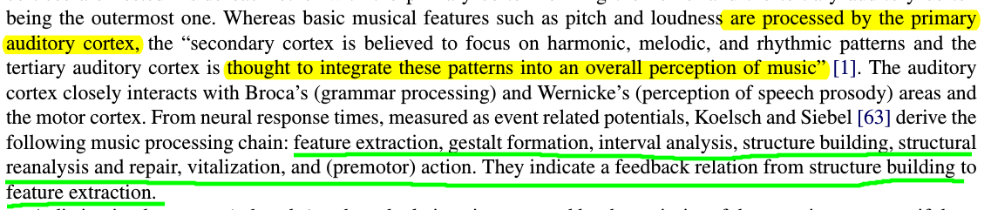
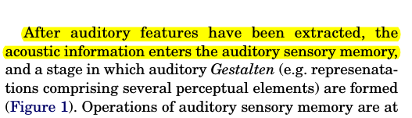
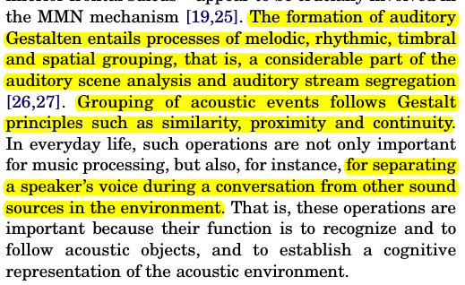
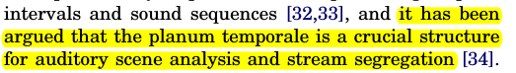
Taking Music for example
g:Vhâ∆…
Lecture1
-
9
ã°{óg:[fñb

Slide 14
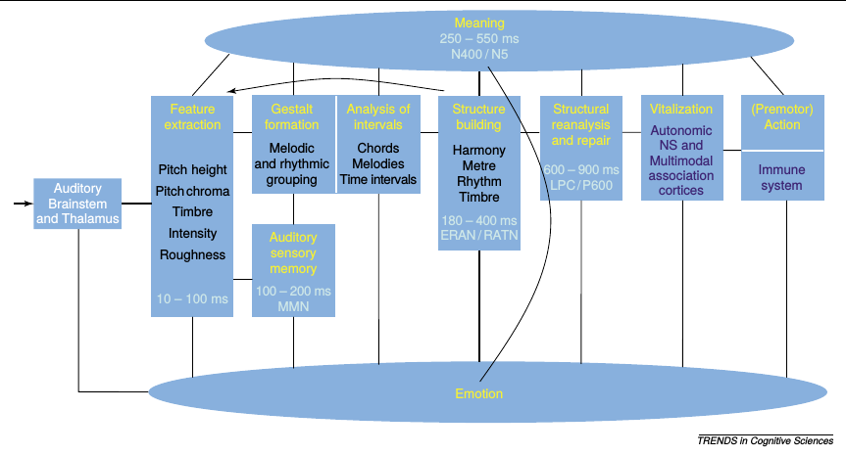
Perceptual and cognitive processing chain
structure building
Koelsch S, Siebel WA. Towards a neural basis of music perception
g:Vhâ∆…
Lecture1
-
9
ã°{óg:[fñb

Slide 15
Perceptual and cognitive processing chain
back
feature extraction
motor action
vitalization
gestalt formation
interval analysis
structural reanalysis and repair
structure building
Koelsch S, Siebel WA. Towards a neural basis of music perception
g:Vhâ∆…
Lecture1
-
9
ã°{óg:[fñb

Slide 16
03
Computational models

Slide 17
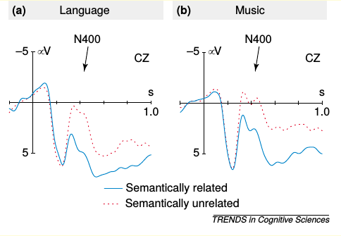
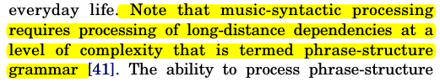
Draw from Language Processing
All types of music show an organization of
perceptually discrete elements (such as tones, intervals and chords) into sequences that are structured according to syntactic regularities . The analysis of structure requires the computation of structural relations between these elements,
......
In this respect, it appears that the human brain, at least at an early age, does not treat language and music as strictly separate domains, but rather treats language as a special case of music.
......
music is capable of conveying meaning information, and that the priming effects on the semantic processing of words can be identical for music and language

Slide 18
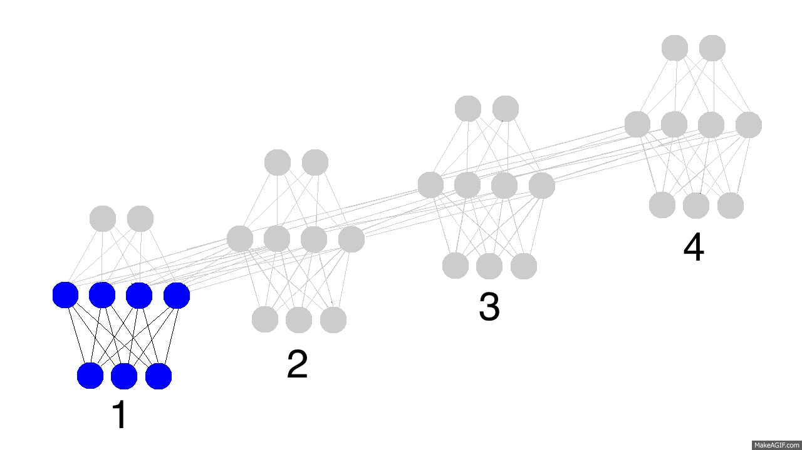
Why Recurrent Neural Networks ?
RNN is a good model to make
use of sequential information
List the alphabet forward.... you can do it, yes?
List the alphabet backward.... hmmm... perhaps a bit tougher.
Try with the lyrics of a song you know?.... Why is it easier to recall forward than it is to recall backward? Can you jump into the middle of the second verse?... hmm... also difficult. Why?
you haven't learned the letters of the alphabet or the lyrics of a song like a computer storing them as a set on a hard drive. You learned them as a sequence. You are really good at indexing from one letter to the next.It's a kind of conditional memory
https://iamtrask.github.io/2015/11/15/anyone-can-code-lstm/

Slide 19
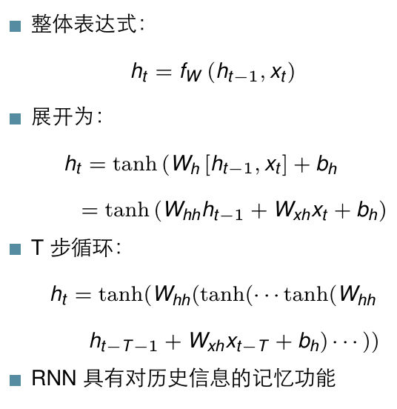

RNN is a good sequential model in CA
g:Vhâ∆…
Lecture1
-
9
ã°{óg:[fñb

Slide 20
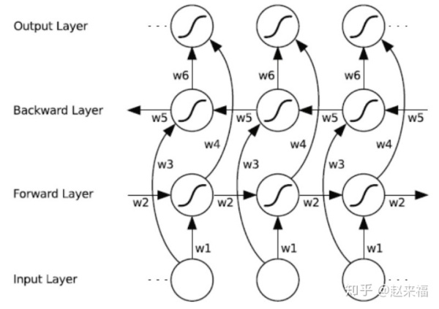
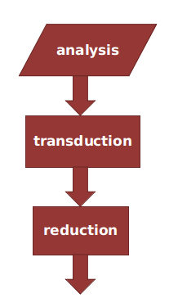
Why Deep Learning ?
Click Here
Feature Extraction
联想：多层 LSTM 网络，低层 LSTM 能学习
到较多的句法结构信息；高层 LSTM 能学习
到更多的语义信息......
g:Vhâ∆…
Lecture1
-
9
ã°{óg:[fñb

Slide 21

In Contrast to Language Processing
Language Processing
Computer Audition
undeniable survival value
outside its own symbols
still controversial
predominantly self-referential
the deep structure of music cannot be a formalized rule system①
Auditory models are quite speculative
Both can be described by Probabilistic Graphical Models
① Chomsky N. Language and problems of knowledge
g:Vhâ∆…
Lecture1
-
9
ã°{óg:[fñb

Slide 22
04
Applications

Slide 23
01
Speech Recognition
02
Audio information Retrieval
03
Auditory Scene Analysis
04
Machine musicianship
05
...

Slide 24
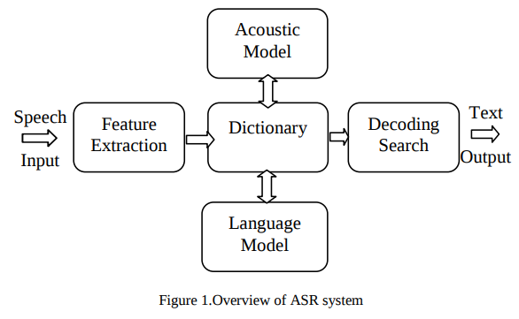
1. Speech Recognition
Speech recognition (is also known as Automatic Speech Recognition (ASR), or computer speech recognition) is the process of converting a speech signal to a sequence of words, by means of an algorithm implemented as a computer program ①.
≈ Feature Extraction
+
Recognition Engine
① Speech Recognition by Machine: A Review

Slide 25
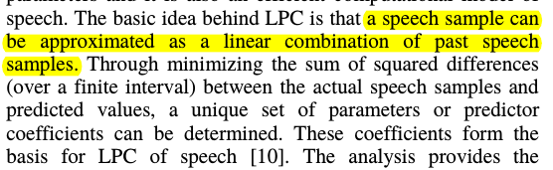
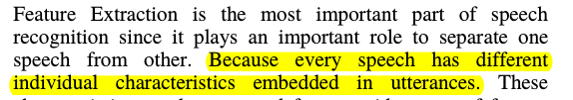
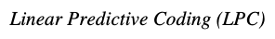
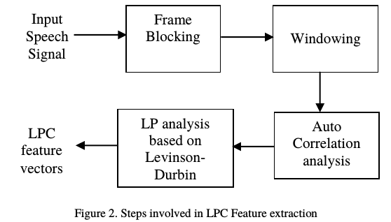
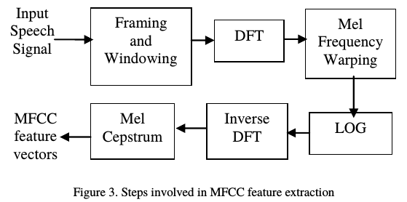
Speech Feature Extraction

Slide 26
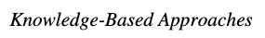
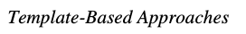
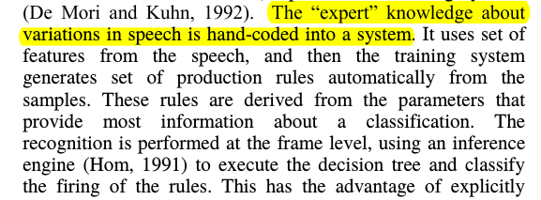
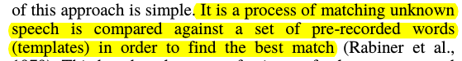
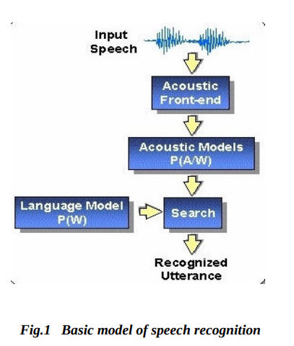
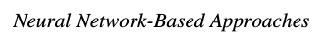
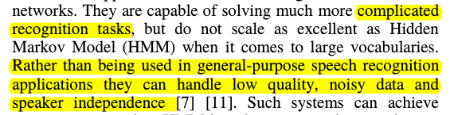
Speech Recognition Engines

Slide 27
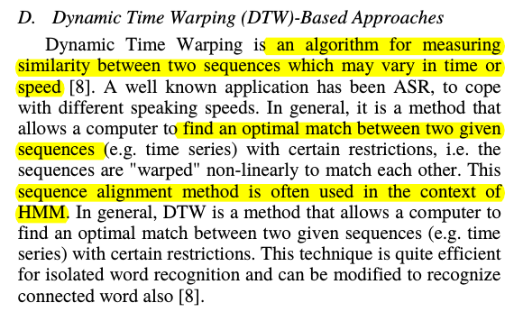
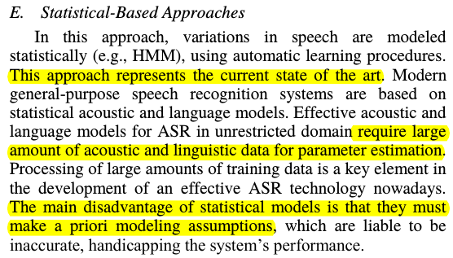
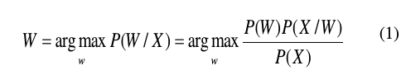
Speech Recognition Engines
When given with acoustic observation X = X1,X2...Xn, the goal is to find out the corresponding word sequence W = W 1,W2...Wm that has the maximum posterior probability P(W|X)

Slide 28
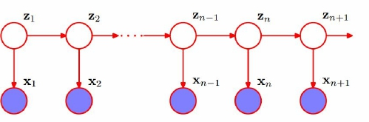
HMM based Speech Recognition Model
How do human produce a speech ?
Analogy
句子 = 若干词性的组合
词性 -> 需要说出的词
I
You
He
It
我
他们
......
want
eat
play
......

Slide 29
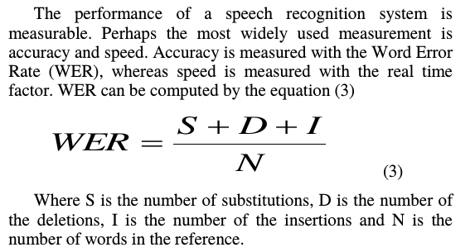
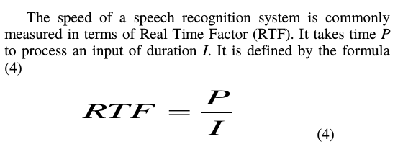
Performance Evaluation
Word Error Rate
Real Time Factor

Slide 30
End-to-End Speech Recognition Model

Slide 31
Encoder-decoder Speech Recognition Model

Slide 32
Attention-Based Speech Recognition Model

Slide 33



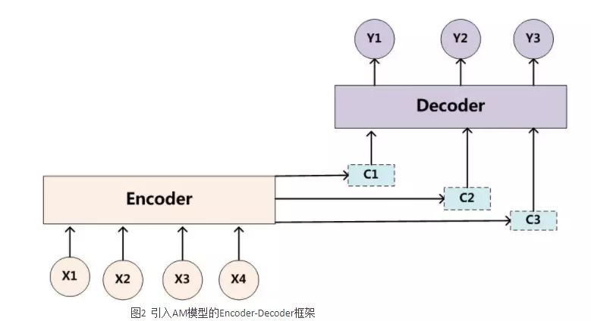
Conbined with NLP
Sentiment Analysis
Text Classfication
Question and Answer
Machine
Translation
There are so many fields that CA can be applied to !

Slide 34

2. Audio information Retrieval
Disciplines involved：speech recognition, information retrieval, audio analysis, signal processing,psychoacoustics, and machine learning
Focus : systems that can automatically extract information from an audio signal
Ideal: semantic retrieval, as it would hopefully retrieve what an intelligent human would
Division: those that assume some speech content in the audio, and those that don’t

Slide 35
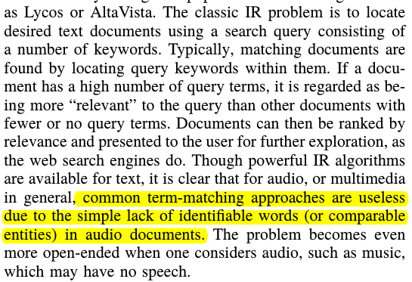
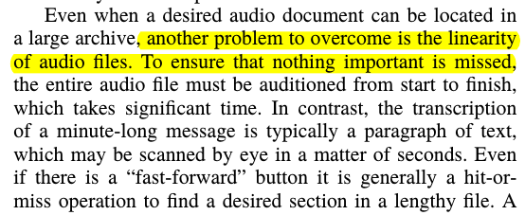
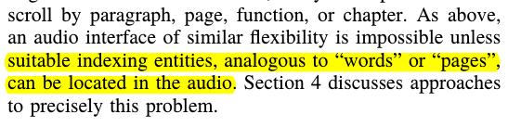
Difficulties
1. Conventional appraoches are useless
2. linearity
3. Lack of similar flexibility

Slide 36
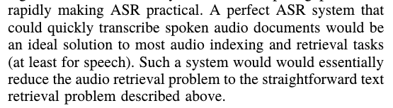

Targeted Technology
1. Automatic speech recognition
1.1 Drawbacks
(1). if a word is not present in the phonetic dictionary, it will not be recognized
(2). a Large-vocabulary language model must be used, and finding sufficient example text may not be possible
(3). Large-vocabulary may be very expensive in terms of computation and storage
(4). Not Universal and only useful for
speech at least.
Text
ASR
Audio

Slide 37
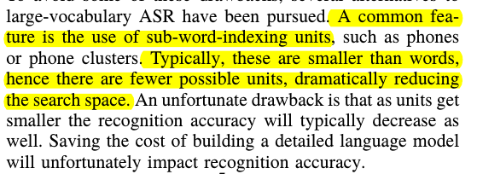
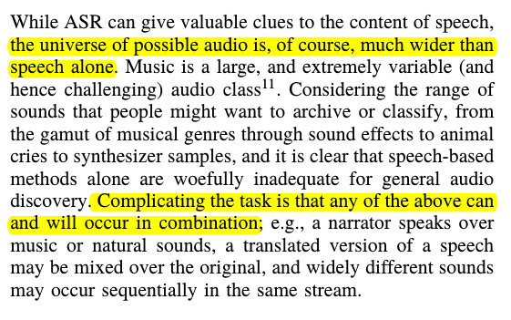
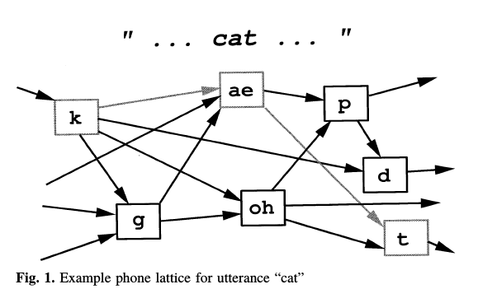
Targeted Technology
1.2 sub-word-indexing units
1.4 Music and audio analysis
1.3 “lattice-based” word spotting(Speed).
Lack of Auditory Scene Analysis !

Slide 38
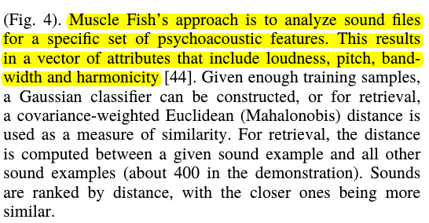
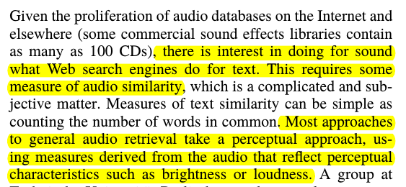
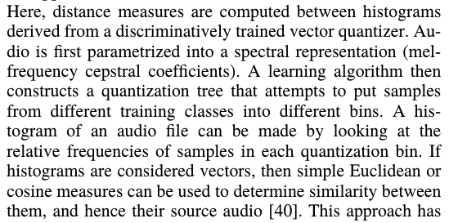
Targeted Technology
(1)psychoacoustic features
2. Content-based retrieval model
(2)a spectral representation
The content-based retrieval applications of the previous section have avoided the problem somewhat by using audio examples as the query, in effect saying “look for things that
sound like this”

Slide 39
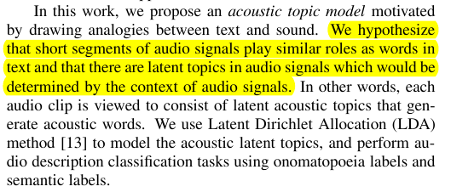
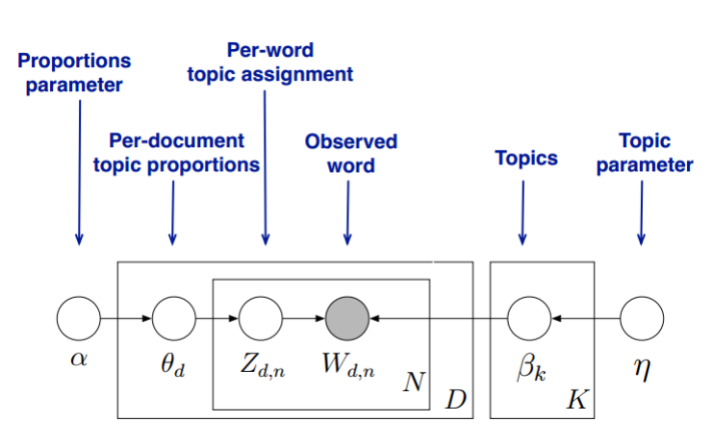
Content-based model : LDA
Acoustic Features
Semantic Features
(Improve the Recall-ratio)

Slide 40


Content-based model : LDA
the proposed acoustic topic model outperforms the conventional SVD-based latent analysis(LPI) method in both onomatopoeia labels and semantic labels.

Slide 41
In Contrast to Information Retrieval
Information Retrieval
Crawling data
Index creation
Intention analysis
Distributed search
Audio Information Retrieval
Crawling data
Sub-word-index Index
Representation
ASR
Similarity Analysis
Relevance measure
Link Analysis
Text search Engine
Audio search Engine
Review on the difficulties

Slide 42
3. Auditory Scene Analysis

Slide 43
Dynamic RNN model

Slide 44
Audio-visual model

Slide 45
05
HuaWei-Cup Compititions

Slide 46
Reference

Slide 47
Thank you
2019.3.23

